Slide 1
Grant Wood – American Gothic

Slide 2
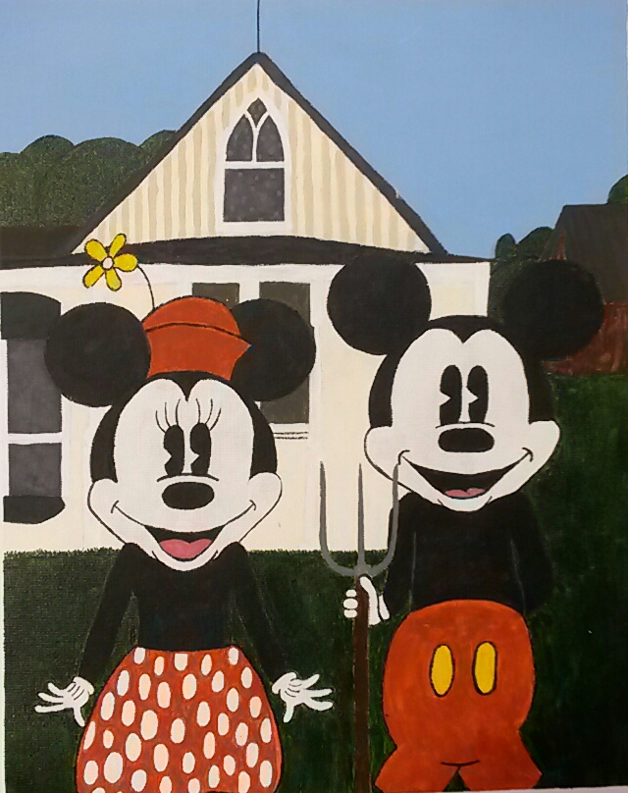
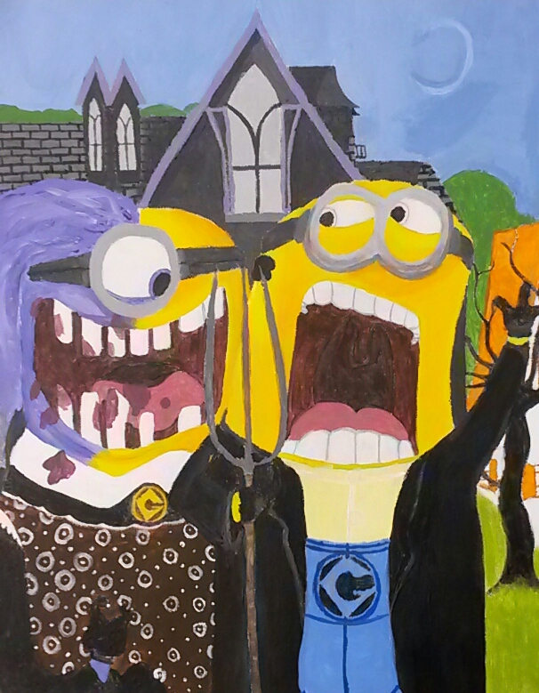
American Gothic Parody Painting

Slide 3
Parody:
an imitation of the style of a particular writer, artist, or genre with deliberate exaggeration for comic effect

Slide 7
Process:
Research a well-known couple from Pop-Culture. Find quality pictures to use as references.
Consider what building/structure can imitate the American Gothic style house in the background of the original, but still fit your idea.

Slide 8
Process Continued
Sketch your design on canvas taped to a board. (Use a grid if you’re having trouble with proportion.)
Paint your parody imitating Grant Wood’s style.
Be mindful of clean lines, skin tones, small details, etc.
You’re not finished until your painting resembles Grant Wood’s, your Pop-culture couple is recognizable, along with a matching structure in the background.

