Slide 1
Extended Photo Art 1 Final Project

Slide 2
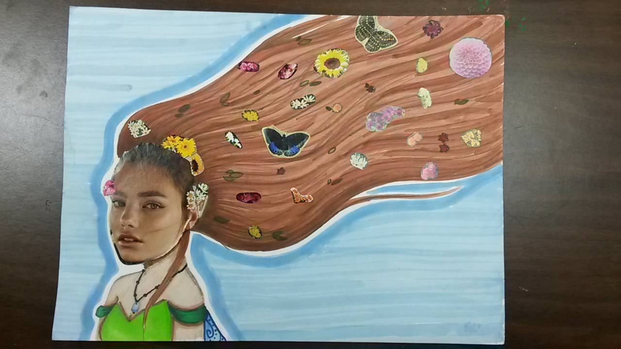

Slide 3
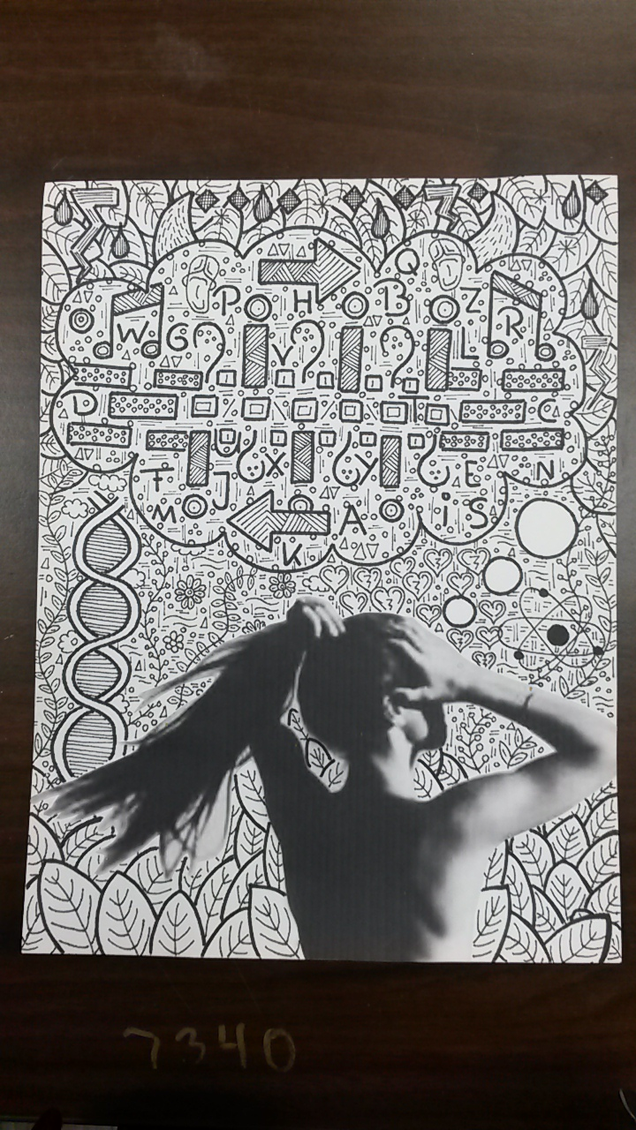

Slide 4
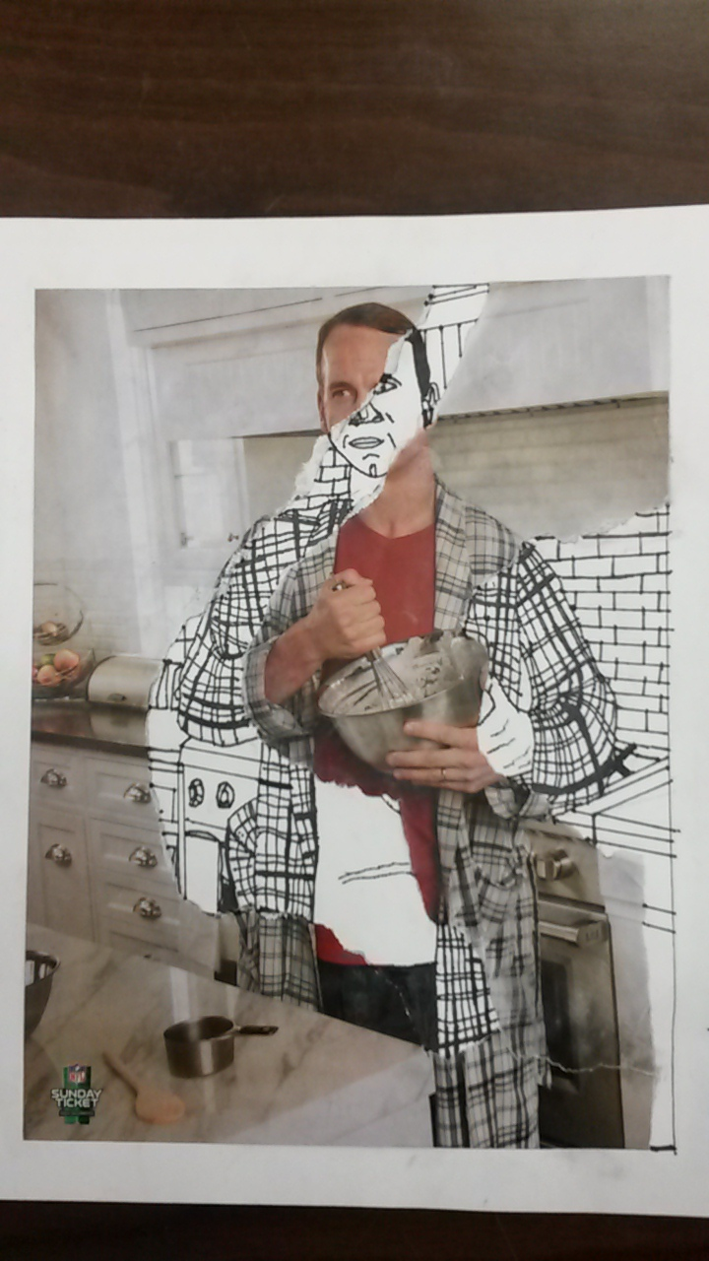

Slide 5
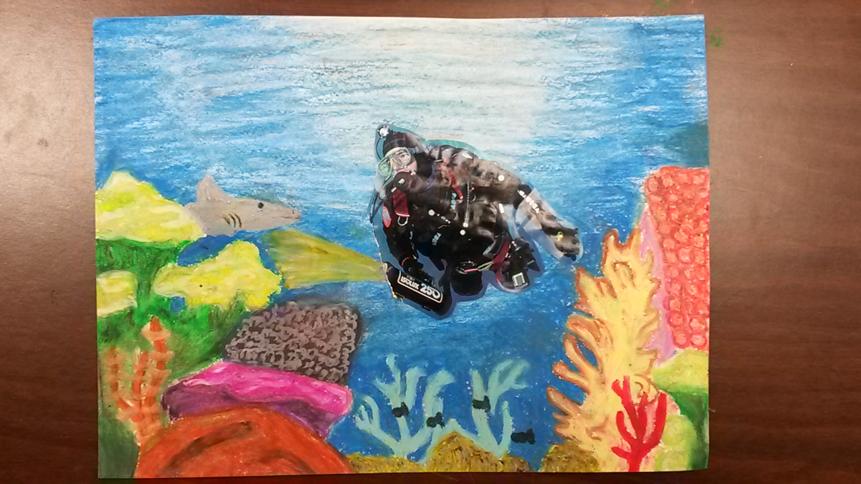

Slide 6
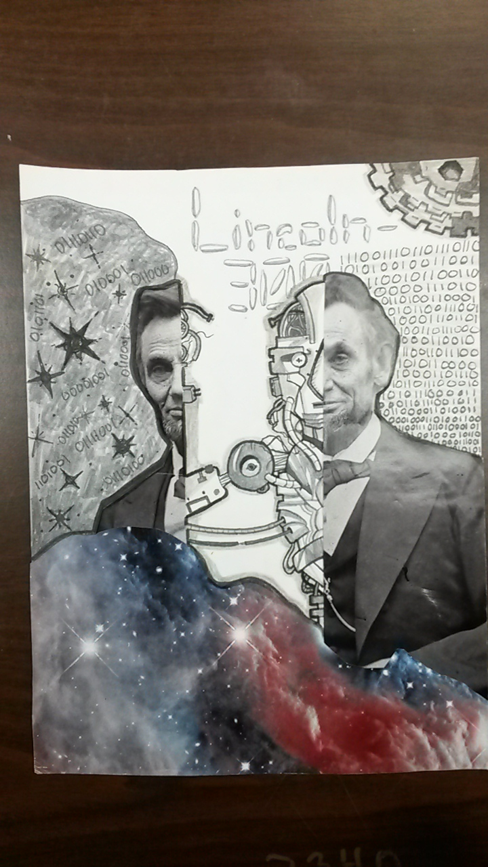

Slide 7
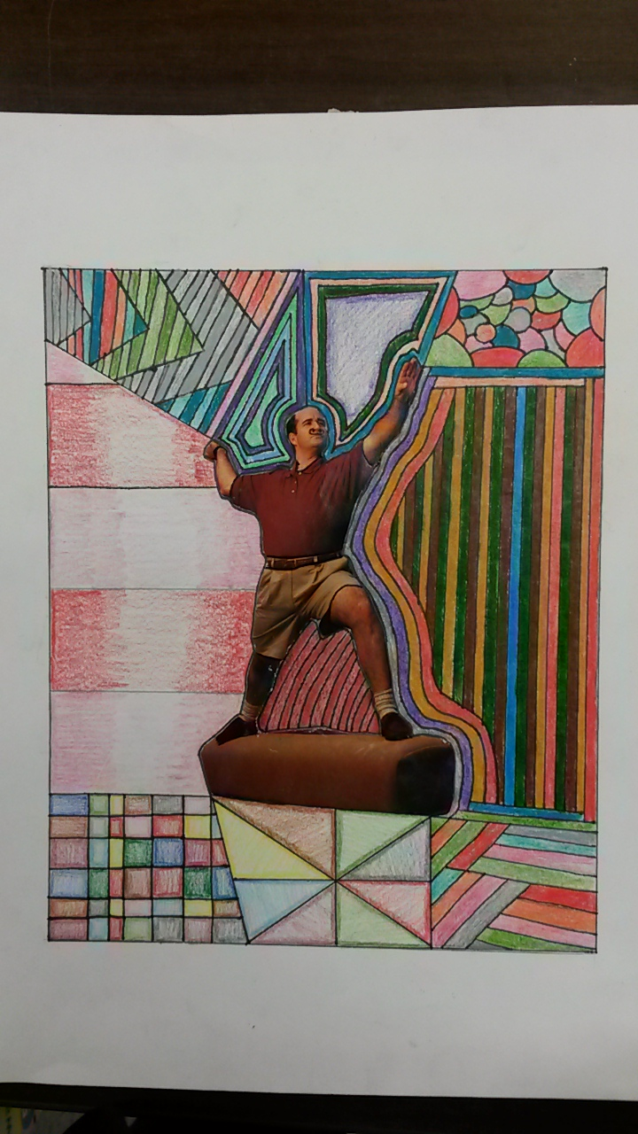

Slide 8
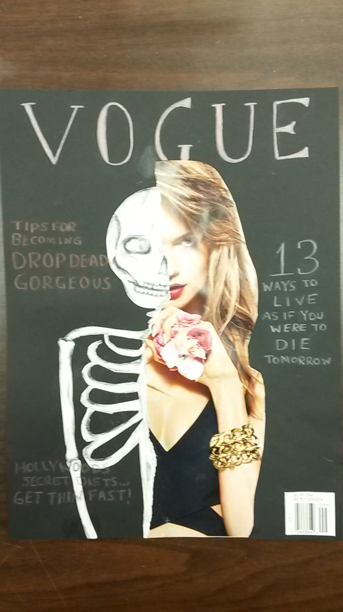

Slide 9
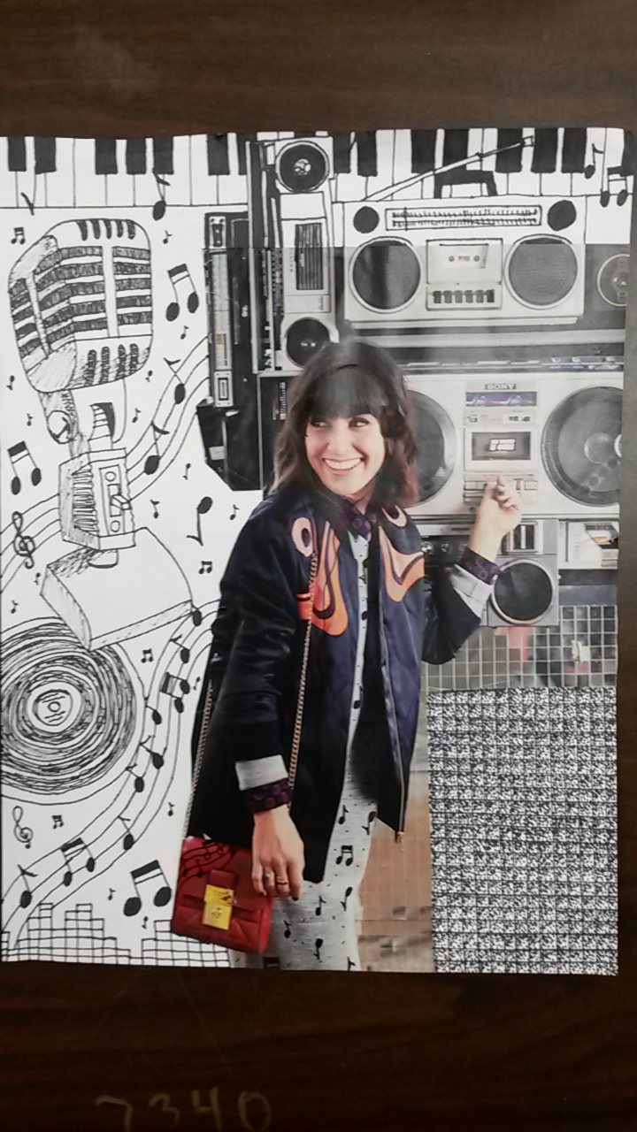

Slide 10
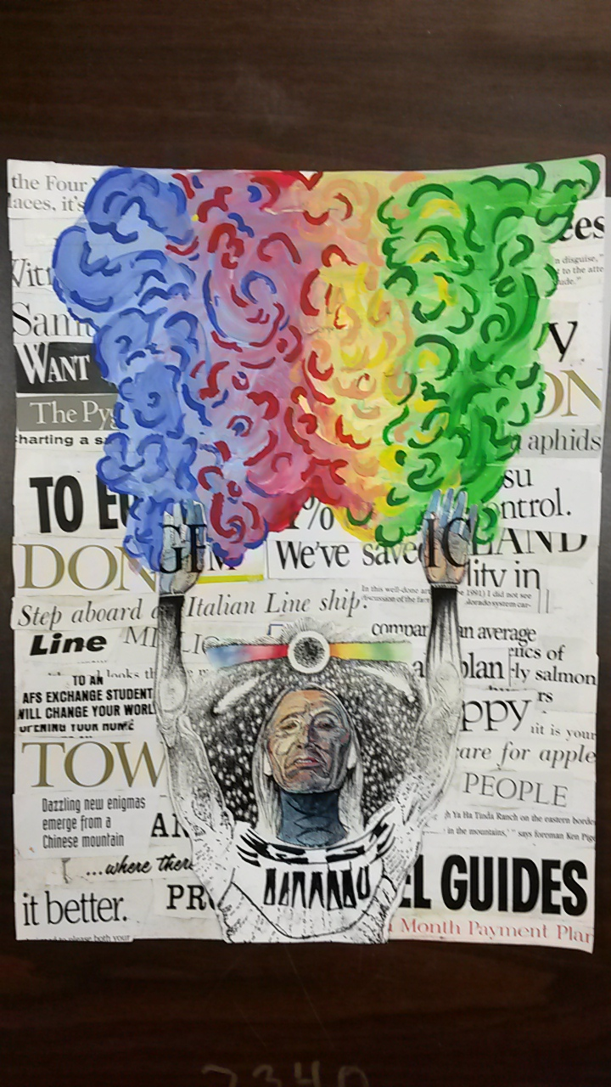

Slide 11
CRITERIA
Find a magazine photo that speaks to you.
Rip it, cut it, collage it and EXTEND IT.
You may use one or multiple media we have used during the semester to extend it.
Your design must be complex and challenging enough to qualify as a final project.

Slide 12
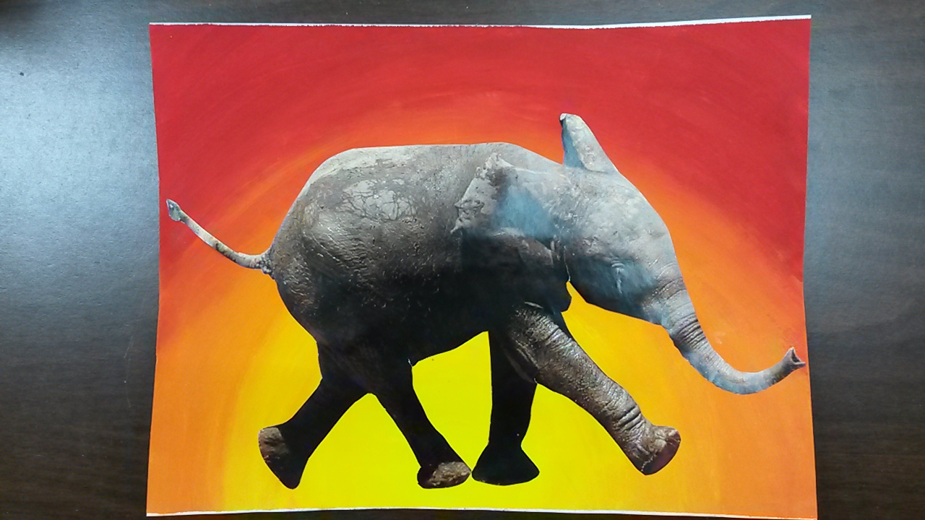
THIS IS NOT ENOUGH FOR A PASSING GRADE!

