Slide 1
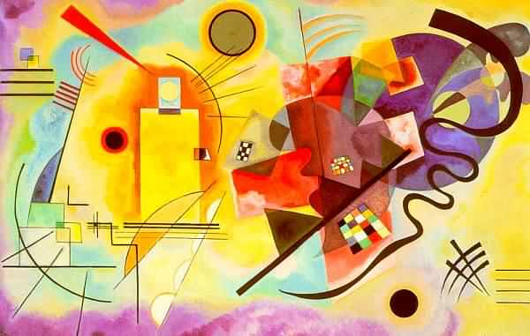
Kandinsky Inspired Watercolor Painting

Slide 2
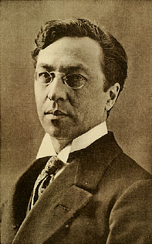
Wassily Kandinsky 1866-1944

Slide 3
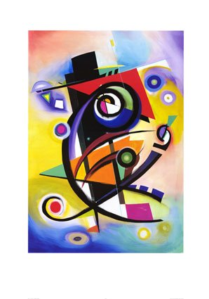
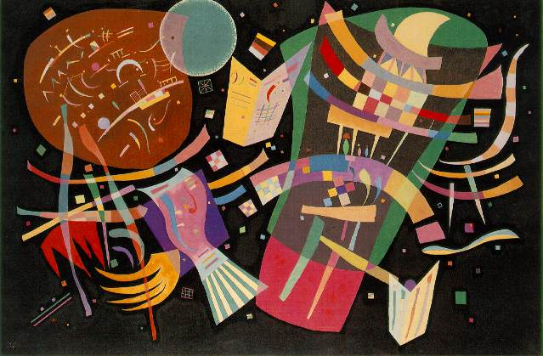
Kandinsky was very spiritual about his art making.
His belief in art is based on the harmony of color and form.
He believed that every color had an inner voice and a meaning.

Slide 4
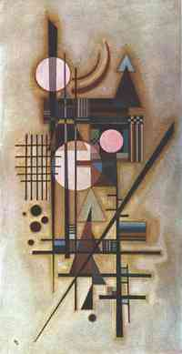
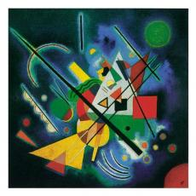
He carefully planned each painting to express, through the colors and abstract forms, exactly the feelings and spiritual ideas he wished to communicate.

Slide 5
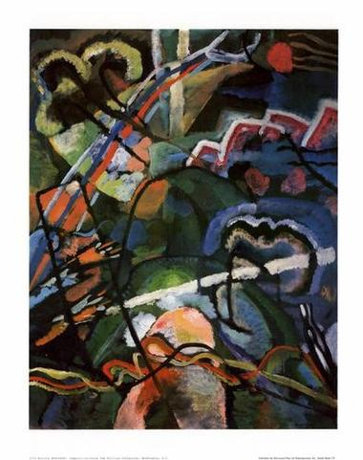
Title: Storm (Visual Thinking Strategies)
How does this painting make you feel?
What colors do you see?
What colors do you see the most of?
Is there any place in this painting that seems restful to you? How?
What types of lines do you see?
Would you like to be standing in the middle of this painting?
Does anything in this painting remind you of a storm?
What do you think it would feel like? Why?

Slide 6
Experimentation
We are going to experiment with watercolors.
We will be using:
Rubber cement resist
Crayon resist-scrape a design in afterword
Oil pastel resist-scrape a design in afterword
Salt
Rubbing alcohol
Wet watercolor paper
Use straws as droppers
Toothbrush spritz
Watercolor pencils
Scrape away at a thick wash
Etc…

Slide 7
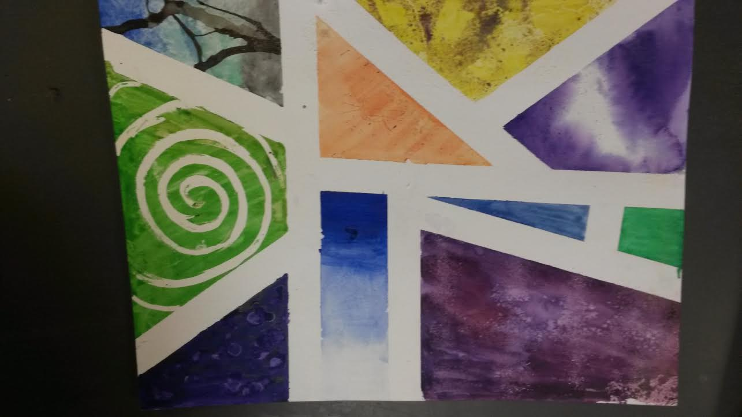

Slide 8
After Experimentation…
We’ll paint an abstract watercolor painting.
What does ABSTRACT mean?

Slide 9
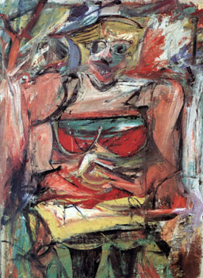
Since abstract art first appeared, many people had difficulty understanding and struggling to accept it as art.
If you are one of these people – don’t worry. Let me explain…
Willem de Kooning, “Woman V” 1952-53

Slide 11
Understanding Abstract Art is like finding images in the clouds.
It’s in the eye and spirit of the beholder – YOU
Most people say that no matter what mood you’re in, you can look at a piece of abstract art and still be able to relate to it in some way –
Everyone brings their own unique interpretation to abstract art.

Slide 12
How to look at abstract art.
Through a simple meditative practice, the viewer (you) takes an active part in creating the meaning of the artwork.
Try this method
Simply sit back – close your eyes, relax – slowly open them and just stare at the artwork.
Don’t think – just stare…stay in the present moment.
Ask yourself – what do you feel? Is it sad, angry, excited etc….
Ask yourself – why does this work make you feel this way? Is it because of the colors, lines, space, etc….
Now – look at it more closely, can you put a concept, story or meaning that is personal to you in this work through relating the elements of the art with your life?

Slide 13
Realism vs. Abstraction
Realism presents the viewer an artist’s interpretation or representation of the world in its complexity and simplicity.
Realism mimics the outer world in a variety of styles and techniques.
Realism hopes to answer “what is it?”
Abstraction presents the viewer an artist’s reaction to the world in its complexity and simplicity.
Abstract expresses the inner world in a variety of styles and techniques.
Abstraction hopes to answer “what is it saying?”

