Slide 1
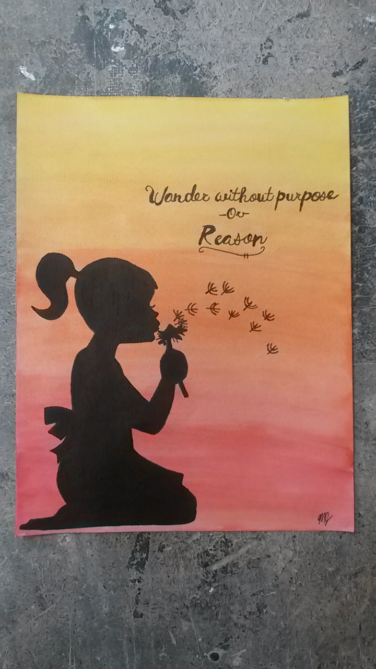
SILHOUETTE QUOTE PAINTING

Slide 2
RESEARCH-DAY IN THE LAB
FIND A QUOTE AND A SILHOUETTE IMAGE THAT WORK TOGETHER
PASTE THEM INTO A DOCUMENT
CHANGE THE FONT TO FIT THE “FEEL” OF THE QUOTE AND IMAGE
CHANGE THE SIZE OF THE QUOTE AND THE IMAGE TO FIT THE SPACE (page orientation)
MAKE SURE THE QUOTE FLOWS (break up into multiple lines, areas of page that make sense)
CHECK WITH ME BEFORE YOU PRINT

Slide 3
WATERCOLOR WASH
THINK OF THE COLORS THAT WILL WORK BEST WITH YOUR QUOTE/IMAGE
USE A LARGE BRUSH TO “WASH” THE WATERCOLOR PAINT OVER THE PAGE.
CHOOSE 1 DIRECTION FOR BRUSH STROKES
BLEND YOUR COLORS BY OVERLAPPING BRUSH STROKES
MORE WATER=LESS VIBRANT COLORS
LESS WATER=MORE VIBRANT COLORS
ALLOW TO DRY OVER NIGHT

Slide 4
COPY YOUR PRINTED QUOTE/IMAGE
USE A PENCIL TO COPY YOUR PRINTED QUOTE/IMAGE ONTO YOUR WATERCOLOR
USE A SHARPIE TO DEFINE YOUR LINES AND DARKEN YOUR QUOTE/SILHOUETTE
ERASE ALL OTHER PENCIL MARKS/SMUDGES

