Slide 1
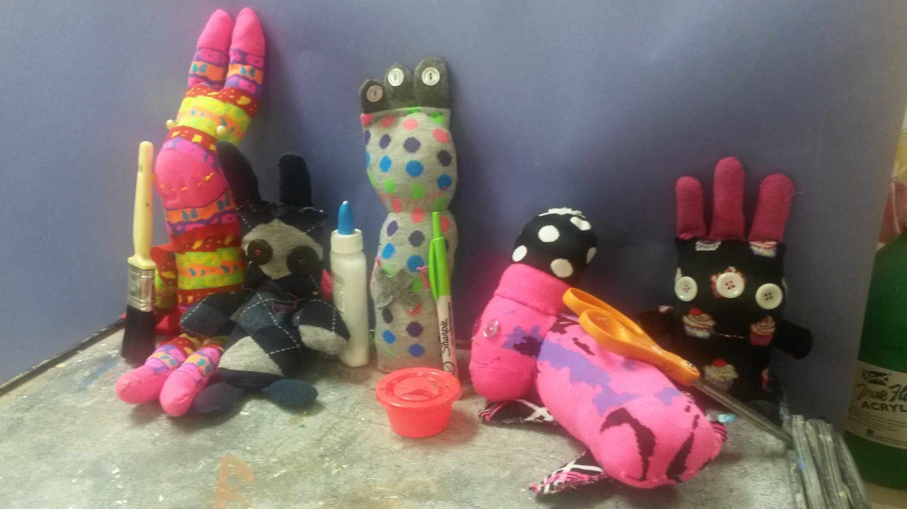
Stuffies

Slide 2
Draw 3 stuffy sketches-choose 1 to make
Practice stitching on scrap fabric
Cut and sew fabric
Stuff your monster and sew shut
Add detail like buttons, zippers, etc.

Slide 3
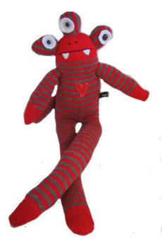

Slide 4
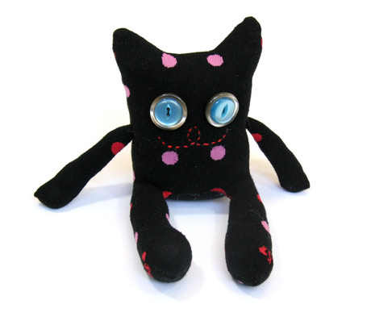

Slide 5
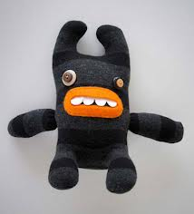

Slide 6
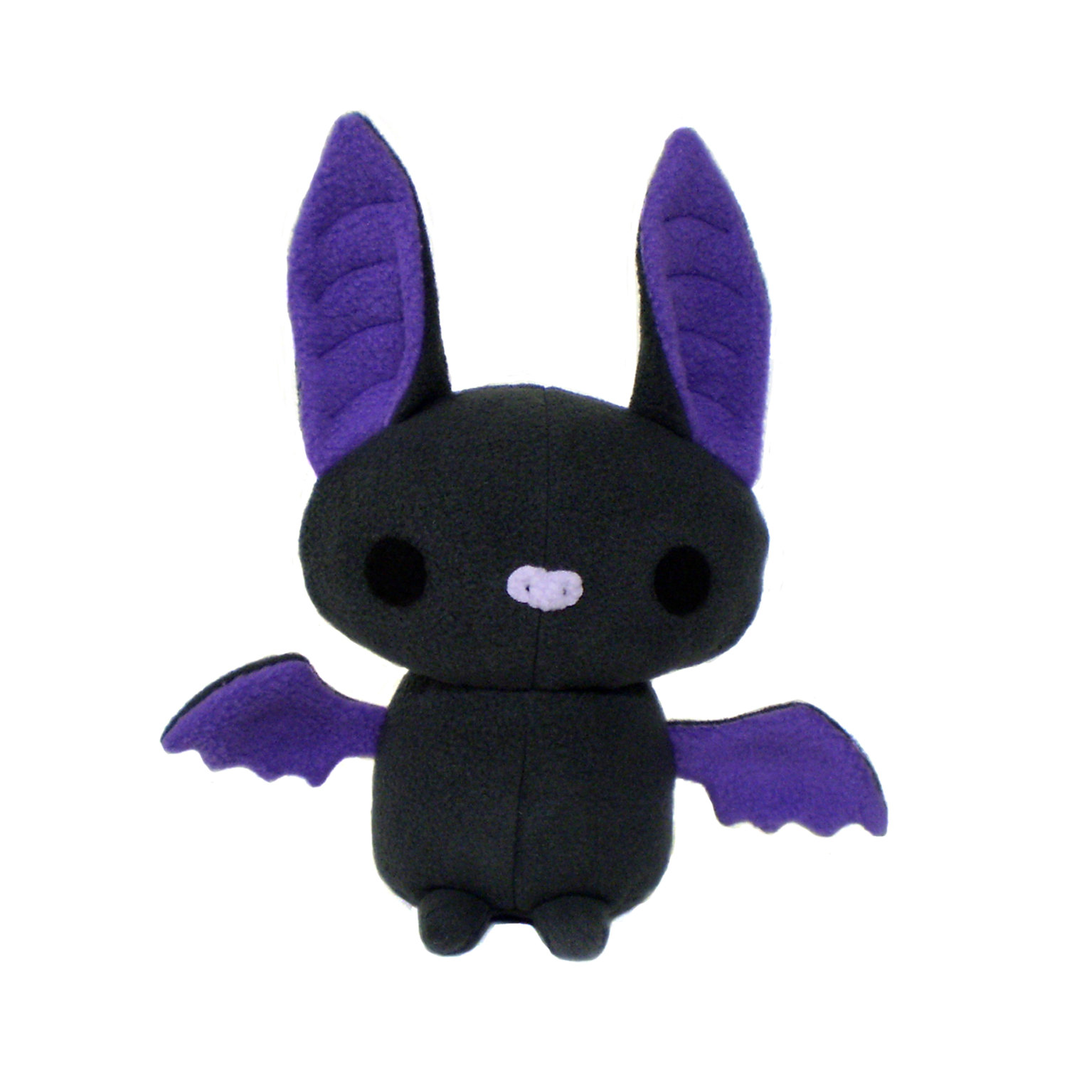

Slide 7
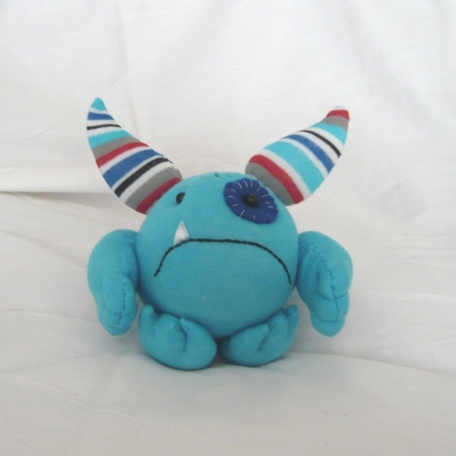

Slide 8
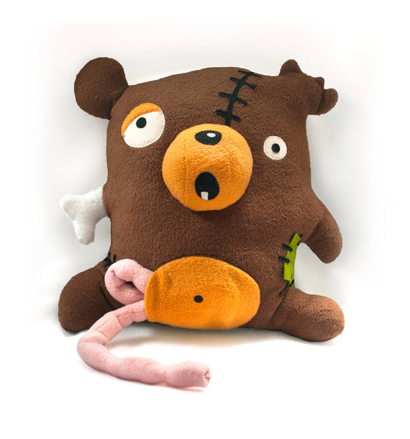

Slide 9
So ugly that
they are cute!

